Slide 1

Advanced Cold Chain – TTx Thermal Bags
June 2016
©2016 CVS Health and/or one of its affiliates: Confidential & Proprietary. Not for further distribution. Do not copy, scan, or duplicate by any means
©2016 CVS Health and/or one of its affiliates: Confidential & Proprietary

Slide 2
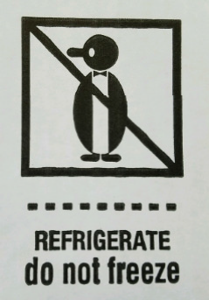
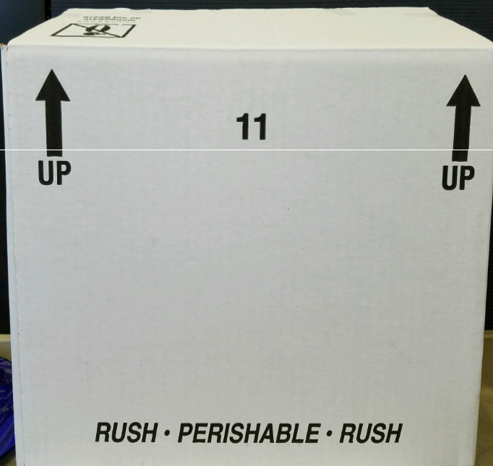
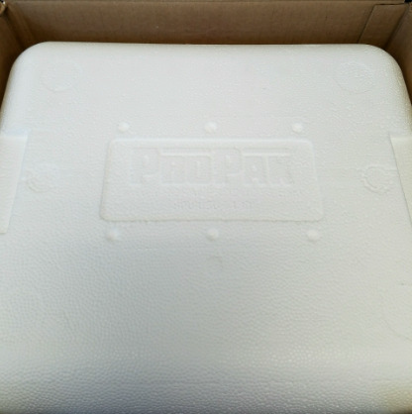
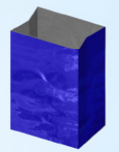
Cold Packing Changes
Outside of the box will indicate cold pack items inside.
A blue thermal bag is placed inside of the cooler.
©2016 CVS Health and/or one of its affiliates: Confidential & Proprietary 2

Slide 3
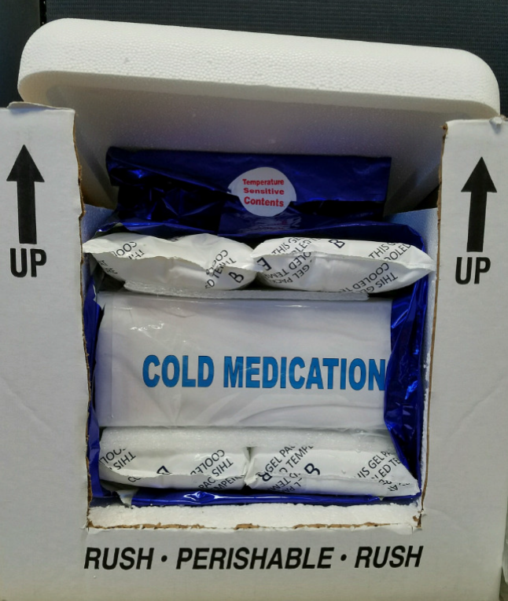


Cold Packing Changes
Cold packed medication will be placed into a clear zipped bag. It will be sandwiched between Stryofoam pads and frozen gel packs.
EXAMPLE:
The amount of frozen gel packs will be determined by the appropriate temperature range of the season.
©2016 CVS Health and/or one of its affiliates: Confidential & Proprietary 3

Slide 4
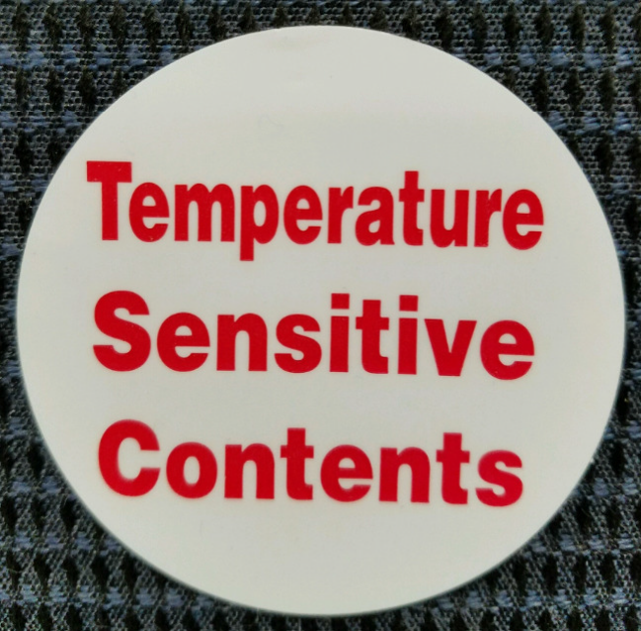
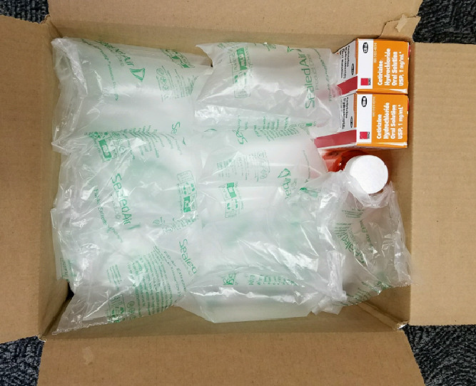
Cold Packing Changes
The blue thermal bag will be sealed with a tamper – resistance sticker to indicate:
If non-cold items are in the order, these will be packed into a Tall box, secured with air pillows, and placed on top of the cooler
©2016 CVS Health and/or one of its affiliates: Confidential & Proprietary 4

Slide 5
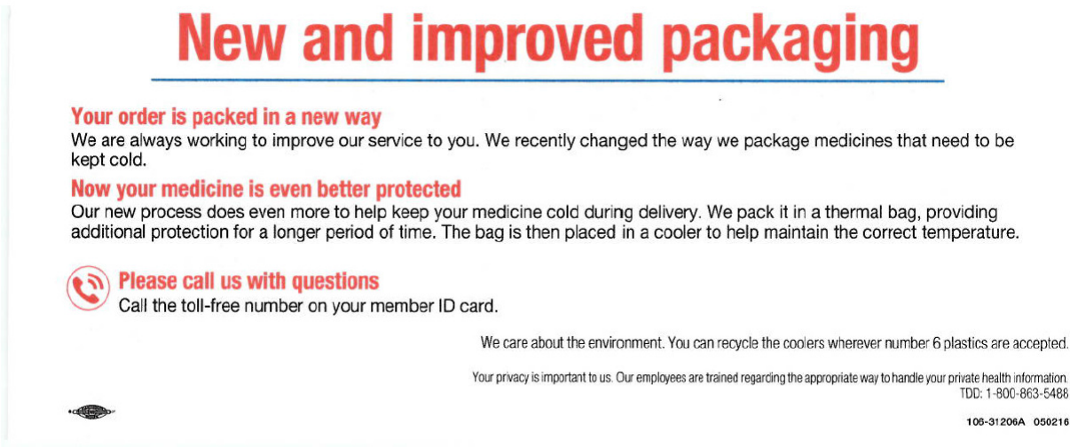
Member Information Slip
©2016 CVS Health and/or one of its affiliates: Confidential & Proprietary 5

